Slide 1
Organ Transplantation in Wan Fan Hospital
Ming-Che Lee, M.D.
Deputy superintendent, Wan Fang Hospital, TMU, Taipei, Taiwan
Director, TMU Organ Procurement Organization, Taipei, Taiwan
Director, Organ Transplantation Center, Wan Fang Hospital, Taipei, Taiwan
Chairman, Department of Surgery, Wan Fang Hospital, TMU, Taipei, Taiwan
Professor of Surgery, School of Medicine, College of Medicine, TMU, Taipei, Taiwan
2023 Taiwan-Somaliland Medical Conference, August 13rd 2023, Hargeisa, Somaliland

Slide 2

> 5100 miles, 20 hr. 10 min. by flight

Slide 3
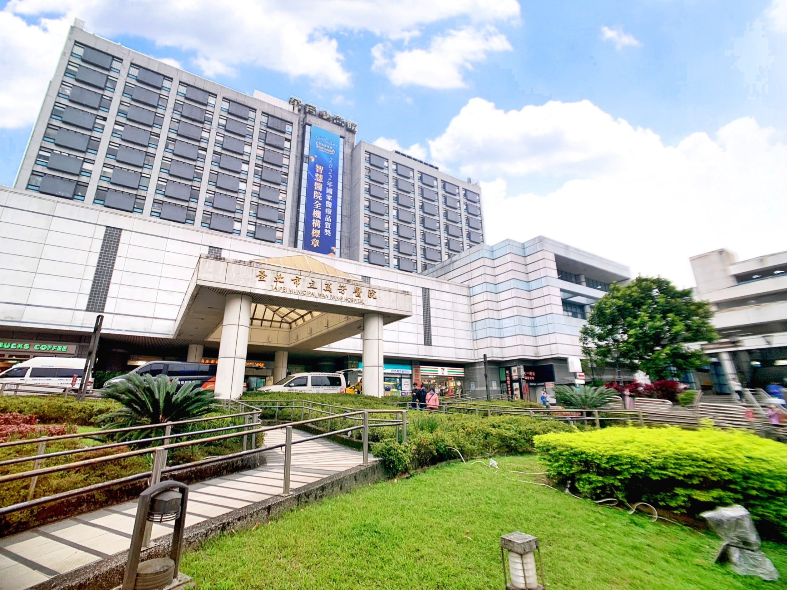
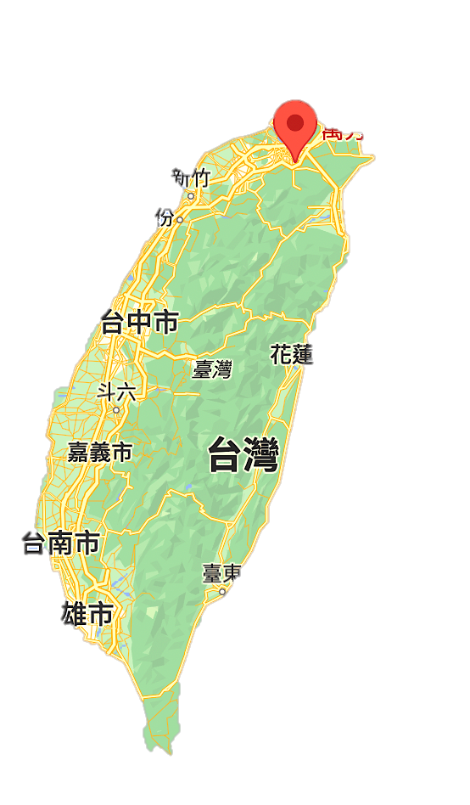
Taipei Municipal
Wan Fang Hospital

Slide 4

History
2019-2022
2023~
2019-2022
DSC certification program- 13 items
3rd AAHRPP certification
4th Operate-Transfer
5th Hosp. accreditation (Medical Center)
1996
First Operate-Transfer
2003
2014
National Innovation Award- 5 items
Symbol of National Quality- 17 items
NHQA Smart Hospital Award
2nd Operate-Transfer
3rd Operate-Transfer
1997
Open
Hosp. Accreditation
2004
2016
First Hosp. accreditation (Medical Center)
4th Hosp. accreditation (Medical Center)
2001
Class A teaching hospital accreditation
2006
2018
First JCI certification
5th JCI certification
4

Slide 5
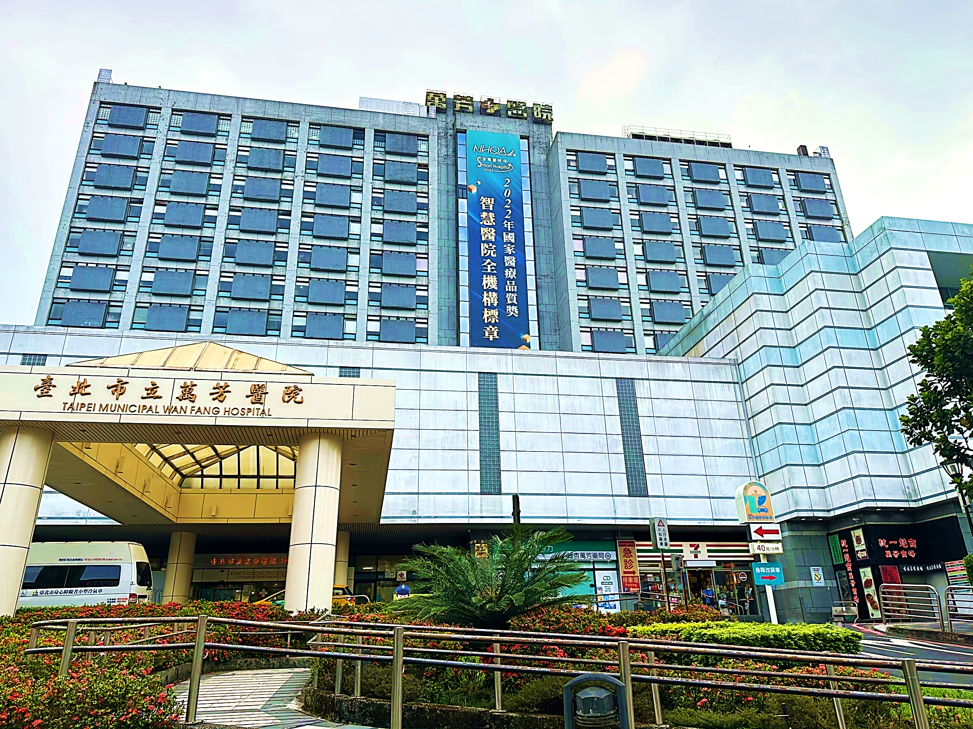
Vision
To be a well-known international high-quality Medical Center
to provide comprehensive medical care for all
5

Slide 6

Scales
Category
General ward | Acute care | Acute general bed | 500
 |  | Acute psychiatric bed | 38
 | Sum |  | 538
Special ward | Intensive care unit |  | 50
 | Burn unit |  | 4
 | Negative pressure isolation unit |  | 12
 | Hospice |  | 10
 | Pediatric unit |  | 25
 | Dialytic unit |  | 61
 | Surgical POR |  | 11
 | ER unit |  | 33
 | Others |  | 6
 | Sum |  | 212
Total |  |  | 750
Operation room |  |  | 15
Obstetric room |  |  | 3
Manpower
Category | Number
Physician | 473 (Attending 282、resident 191)
Nurse | 800
Assistant nurse | 61
Medical staff | 366
Administrative | 389
Others | 328
Total | 2,417
HR Database: 2023.06.01
Notes:
實習醫學生，確認是否包括牙醫？

Slide 7

Academic position
Attending Physician | Number
professor | 33
Associate professor | 29
Assistant professor | 45
Lecturer | 20
Total | 127
45% of total attending physician
Medical staff | Number
professor | 1
Associate professor | 5
Assistant professor | 12
Lecturer | 31
Total | 49
HR Database: 2023.06.01

Slide 8

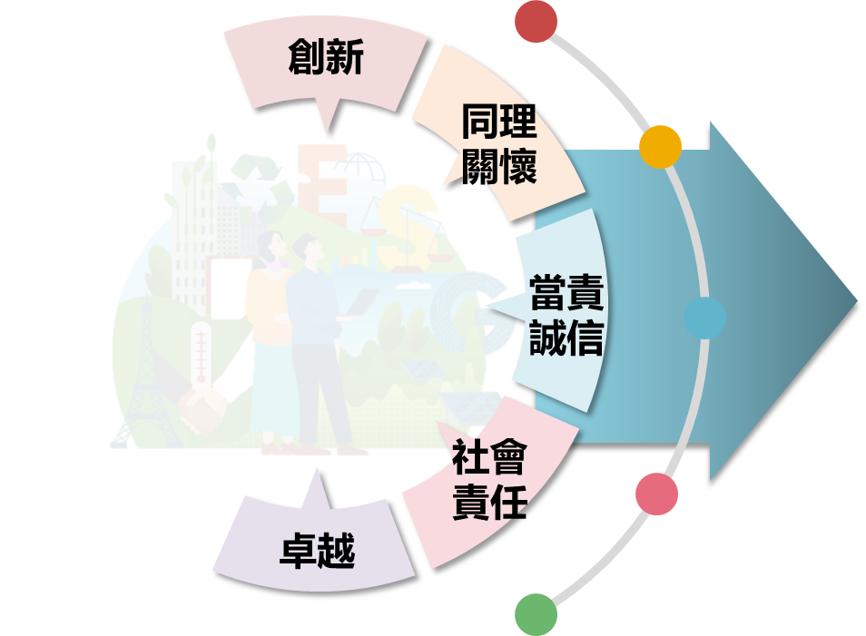

SMART strategy for hospital management
Social impact
深耕社區展現社會影響力
社區
Medical competence
強化醫療提供優質的照護
醫療
VISION
AI hospital
發展智慧醫院高品質服務
品質
深耕社區、培育人才、創新研發、
提供以病人為中心的高品質醫療服務
Research innovation
打造卓越創新研發生態圈
研發
Talent development
建構優質教學與人才發展
教學

Slide 9
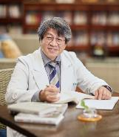
My transplant journey I – MC Lee, M.D.
Transplantation surgery, 1996-2023
Kidney transplantation, visiting research fellow
National Taiwan University Hospital, Taiwan, 1996. (Prof. Lee PH)
Tokyo Women’s Medical University Hospital, Japan, 2008. (Prof. Tanabe K.)
Liver & pancreatic transplantation, visiting research fellow
Thomas E. Starzl Transplantation Institute, University of Pittsburgh Medical Center, USA, 1997. (Prof. Thomas E. Starzl)
Kyoto University Hospital, Japan, 2005. (Prof. Egawa H.)
Clinical transplantation
TCH era (1997.5-2021.6): 173 DDKT, 65 LDKT, 45 DDLT, 36 LDLT
TMU era (2021.8-2023.6): 21 DDKT, 13 LDKT, 3 DDLT, 5 LDLT
Story is still on going

Slide 10
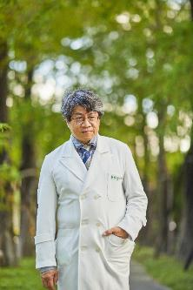
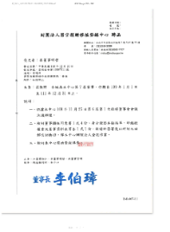
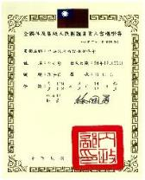
My transplant journey II – MC Lee, M.D.
Transplant organization, 2008
Member of the Council, The Transplantation Society of Taiwan, Taipei, Taiwan, November 2011 – present.
Board of Director, Taiwan Organ Registry and Sharing Center, Taipei, Taiwan, January 2011 – present.
President, Organ Donation Association, R.O.C., September 2017- present.

Slide 11
First organ transplantation in Taiwan
Year | Organ | Institute
1968 | Kidney | National Taiwan University Hospital
1984 | Liver | Chang Gung Memorial Hospital, Linko
1984 | Pancreas | Chang Gung Memorial Hospital, Linko
1987 | Heart | National Taiwan University Hospital
1991 | Lung | Taipei Veteran General Hospital
2007 | Small bowel | Far East Memorial Hospital
Notes:
In 1968, Professor Chung-Jen Lee perforemed the first kidney transplantation in national Taiwan University Hospital using a live donor. In the following 40 years, all the visceral organ transplantation such as liver, pancreas, heart, lung and small bowel has been accomplished and was considered to be a standard treatment of choice for end-stage organ failure patient in Taiwan.

Slide 12
Kidney transplantation in Taiwan
2005-2022 Kidney transplantation (oversea transplantation excluded)
Deceased donor Living donor
(Data source: Taiwan Organ Registry and Sharing Center)

Slide 13

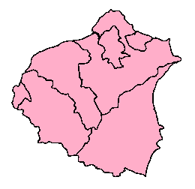
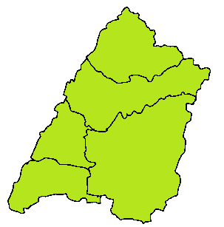
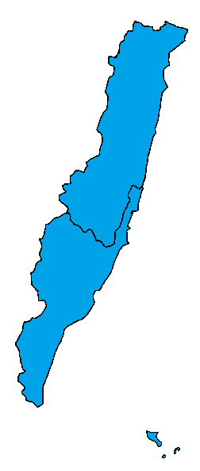
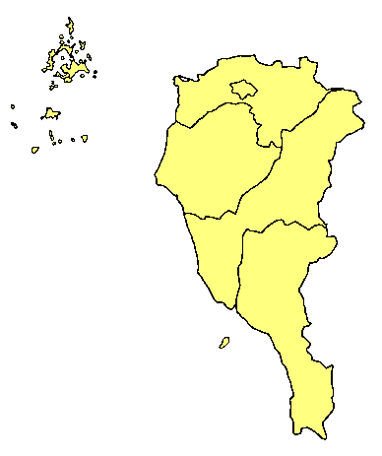
Organ Procurement Organization in Taiwan
Northern Taiwan OPO (NTOPO)
北區器官勸募網絡
Northern Taiwan OPO
National Taiwan University Hospital
Tri-service General Hospital
Taipei Veteran General Hospital
Chang Gang Memorial Hospital, Linko
Far East Memorial Hospital
Wan Fang Hospital, TMU
中區器官勸募網絡
Central Taiwan OPO
器官 Organ |  | 移植醫院Transplant center
心臟 Heart |  | 10
肺臟 Lung |  | 6
肝臟Liver | 屍體 deceased | 13
 | 活體 living | 8
胰臟 Pancreas |  | 4
小腸 Intestine |  | 2
腎臟 Kidney |  | 17
眼角膜 Cornea |  | 19
東區器官勸募網絡
Eastern Taiwan OPO
南區器官勸募網絡
Southern Taiwan OPO
Notes:
Now four OPOs regarding to their geographic distribution were contrasted by TORSC. The major hospitals in each region should cooperative to the OPO to promote organ donation. The OPO should arrange the educational activities in issue of organ donation and transplantation to the related hospitals.

Slide 14

Research Center for Organ Transplantation (RCOT)
TMU-RCOT
Transplantation
Donation
Surgery
Medicine
Administ.
Recovery
Family counseling
Support team
TMU-OPO
TX Surgery
CV
General affair
Coordinator
Community
Neuro
Urology
Chest
Social worker
Social worker
Hospital
NS
CVS
GI
Volunteer
TX Surgery
CS
Nephrology
CV
PS
ID
Resp. Therapy
Ortho
MICU
SICU
Ophthal.
Pathology
MICU
Anesthesia
Hospice
Radiology
SICU
Central Lab.
OR
Virus Lab.
Serology Lab.

Slide 15
Organ transplantation and donation committee
OTDC-WH
Tissue bank
Transplantation
Donation
Surgery
Medicine
Administ.
Recovery
Family counseling
Support team
TX Surgery
CV
General affair
Coordinator
Community
Neuro
Urology
Chest
Social worker
Social worker
Hospital
NS
CVS
GI
Volunteer
TX Surgery
CS
Nephrology
CV
PS
ID
Resp. Therapy
Ortho
MICU
SICU
Ophthal.
Pathology
MICU
Anesthesia
Hospice
Radiology
SICU
Central Lab.
OR
Virus Lab.
Serology Lab.

Slide 16
TMU-RCOT
TMU
Affiliation
Partnership
TMU-RCOT
Transplantation center
Procurement center
TMU-OPO
TMUH
OTC
Wan Fang
OTC
Shuang Ho
OTC
Shuang Ho
OPC
Wan Fang
OPC
TMUH
OPC
Non-affiliated
partnership
Shuang Ho OTDC
Wan Fang OTDC
TMUH OTDC
OTC: organ transplantation center
OPC: organ procurement center
OTDC: organ transplantation and donation committee

Slide 17
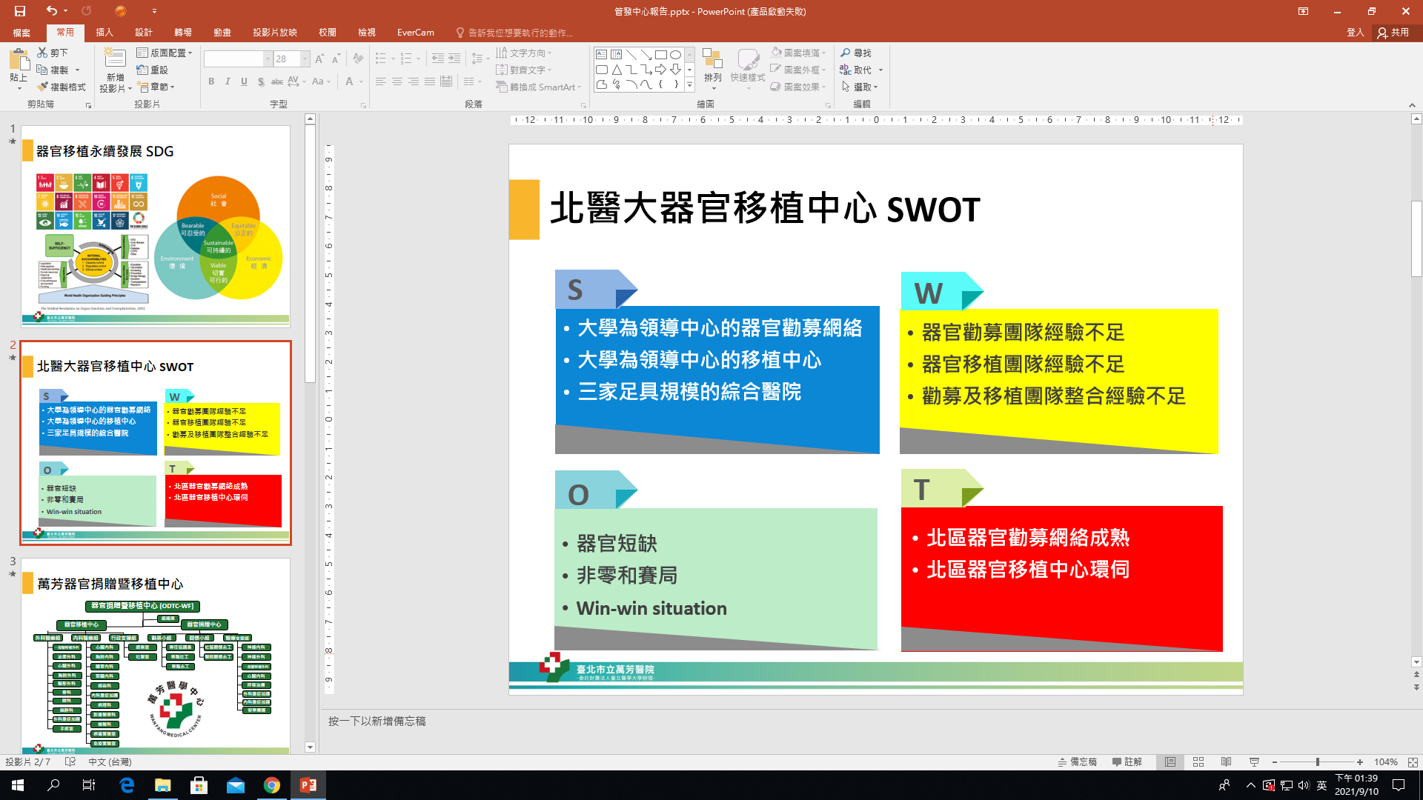
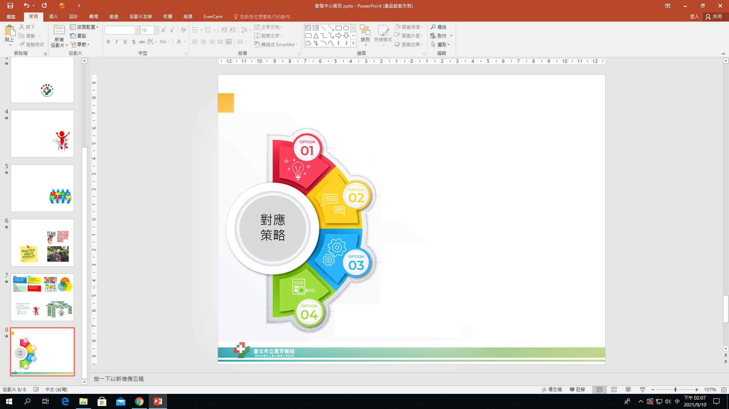
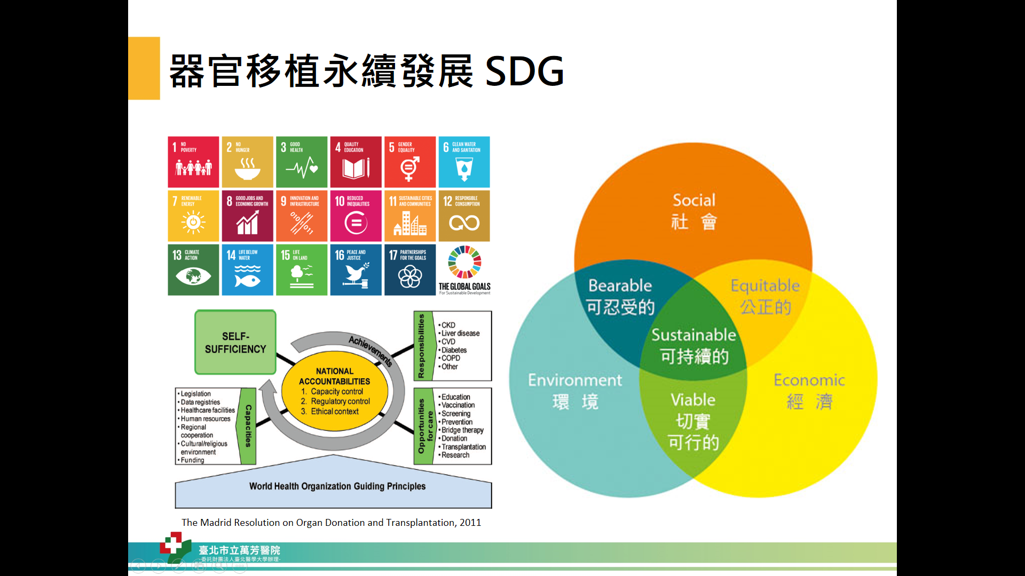
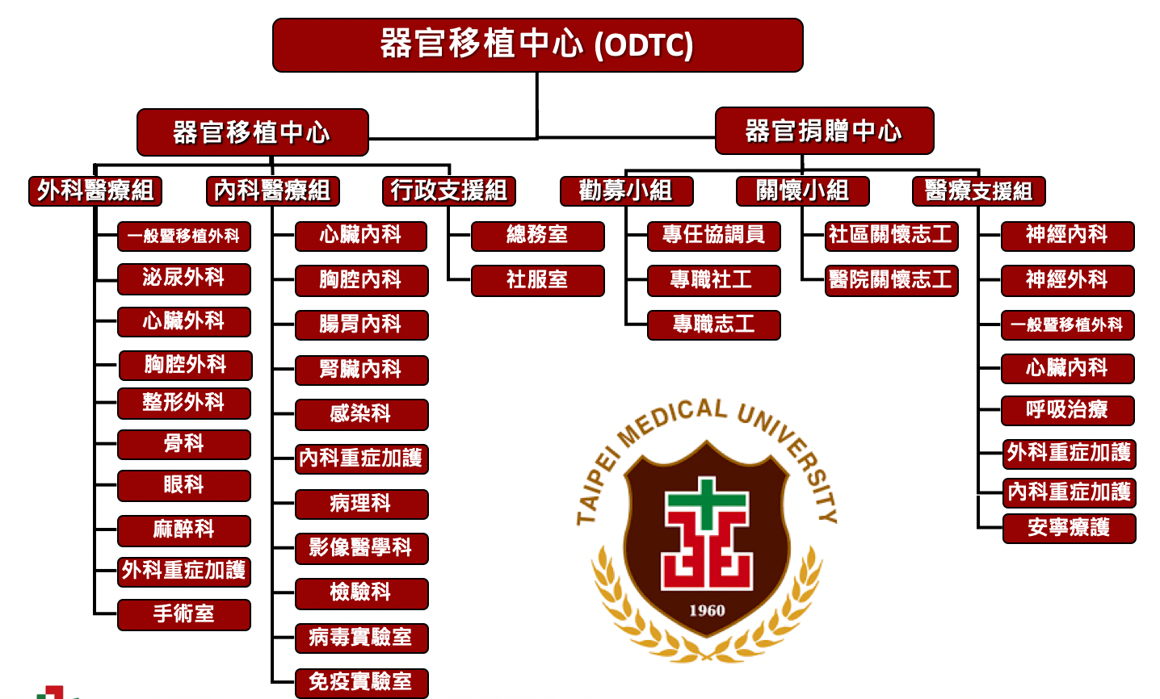
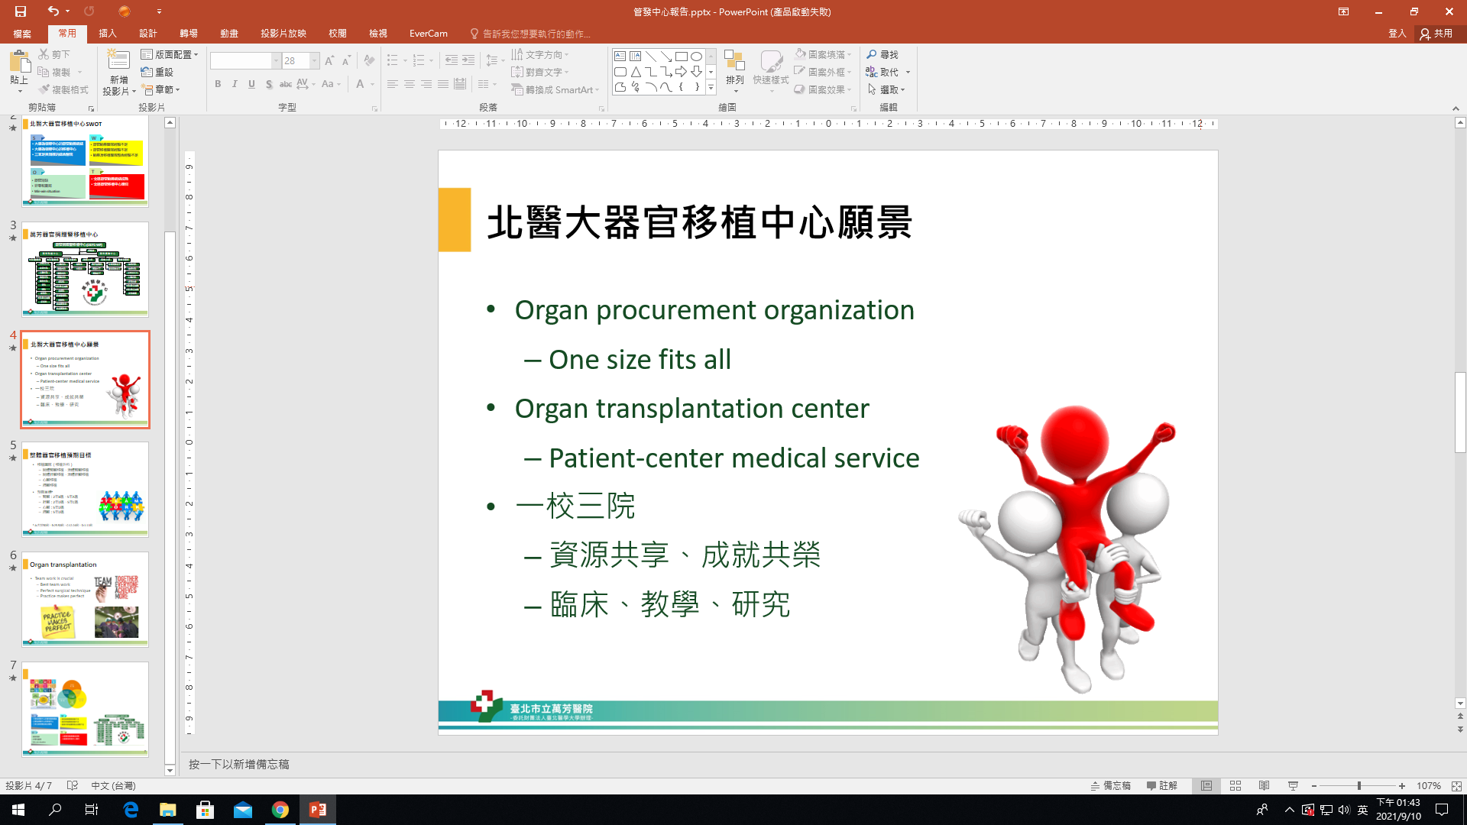
Strategy
戰略
方針
4S
戰略
方針
Strategy
戰略
方針
SDG
戰略
方針
Structure
戰略
方針
Service

Slide 18
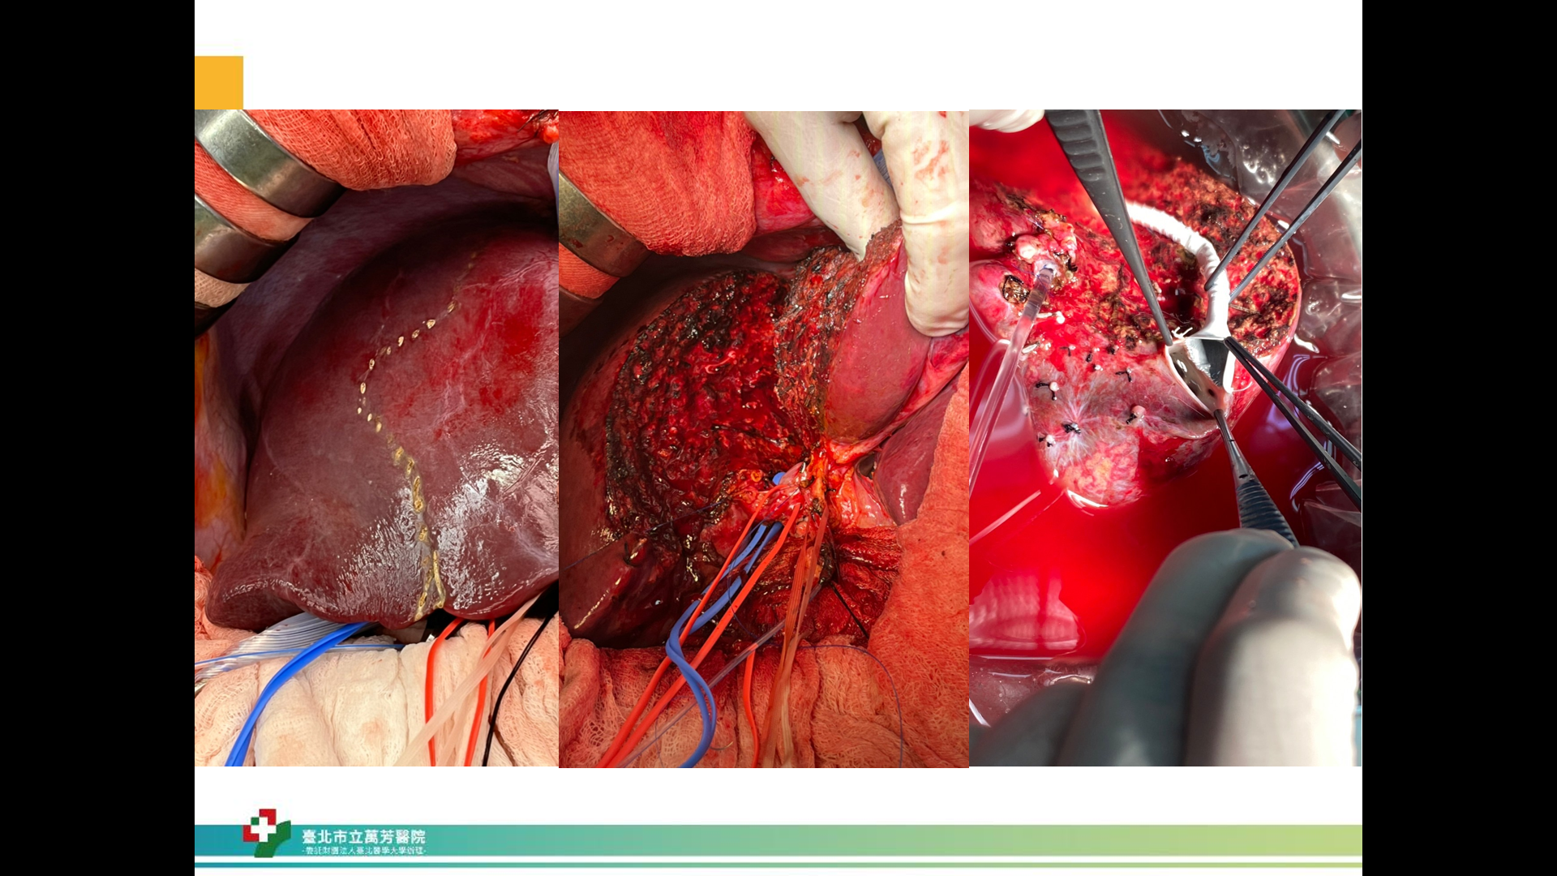
Members - 4 KTX, 2 LTX, 2 HTX
Team work is crucial
Optimal team approach
Perfect surgical technique
Practice makes perfect

Slide 19
Organ donation in Wan Fang Hospital
Organ donation |  | Number
Organ donor (N) |  | 5
Donation after brain death (DBD) |  | 3
Donation after circulatory death (DCD) |  | 0
Donation after death |  | 2
Donated organ/tissue (N) | Heart | 3
 | Lung | 0
 | Liver | 3
 | Kidney | 6
 | Pancreas | 0
 | Intestine | 0
 | Bone | 1
 | Cornea | 10
 | Skin | 1
 | Others (vessels, tendons, etc.) | 0
(Period: 2023.01.01-20230630)

Slide 20
Organ transplantation in Wan Fang Hospital
Organ transplantation |  | Number
 |  | 35
Deceased donor organ transplantation | Heart transplantation | 2
 | Lung transplantation | 0
 | Liver transplantation | 4
 | Kidney transplantation | 5
 | Cornea (domestic) | 14
 | Cornea (foreign) | 7
Living donor organ transplantation | Liver transplantation | 3
 | Kidney transplantation | 0
(Period: 2023.01.01-20230630)

Slide 21
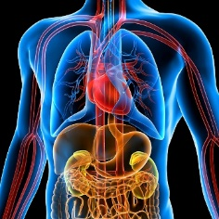

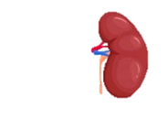
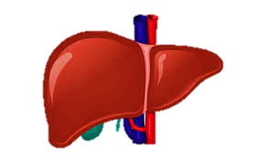
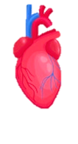
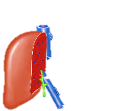
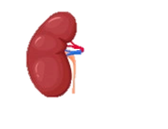
Milestone in organ transplantation
2021-09-24 First donation after circulatory death
2021-11-09 First live donor kidney transplantation
2021-12-19 First deceased donor liver transplantation
2022-07-24 First heart transplantation
2022-08-23 First live donor liver transplantation
2022-11-08 First ABO-incompatible kidney transplantation
2021-2022 DDLT(6), LDLT(5), DDKT(46), LDKT(7), HT (2)

Slide 22
Human Organ Transplantation Act
Promulgated in June 19th 1987, amendment in 2011
Deceased organ is the priority for organ transplantation
Declaration of death regarding to brain death
Rule for brain death declaration in 1987
Guideline for brain death declaration in 2004
Living donor eligibility
Restricted within 3rd degree consanguinity and spouse since 1987
Expanded to 5th consanguinity and spouse since 2002
Notes:
It was three years later following the first liver transplantation that Taiwan government promulgated ‘Human Organ Transplantation Act’ in 1987. It was the first time in Asia to enforce laws regarding brain death. In this Act, it emphasized that the priority of organ source for transplantation would be brain-dead donor. Living donor eligibility was restricted within 3rd degree consanguinity and spouse. But in order to broaden the organ source, the donor eligibility was expanded to 5th consanguinity and spouse in an amendment enacted in 2002. However, organ donations were still small in number and sporadic in the next 15 years. Why?

Slide 23



I-CARE
～Thanks you
Innovation
Compassion
Accountability & Integrity
Responsibility for society
Excellence
Medical Quality is Our Pride

